Slide 1
Python – for loop
Premanand S

Slide 2
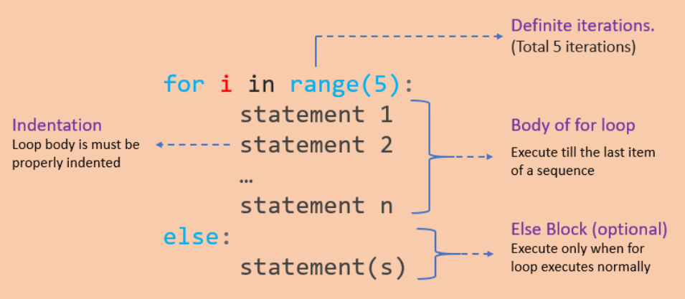
For loop
Used to iterate over a sequence like list, tuple, string or other
Loop continues until we reach the last item in the sequence
Identation

Slide 3
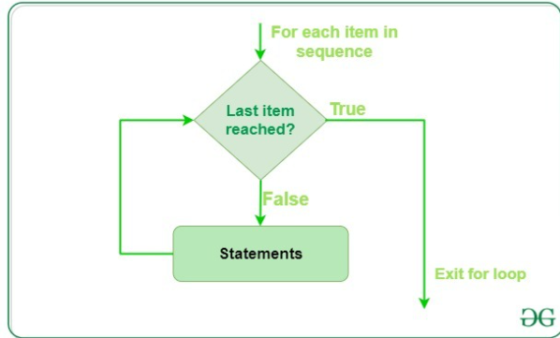
For loop – flow control

Slide 4
Range()
Generate a sequence of numbers using range() function
range(start, stop,step_size)
Not an iterator since it supports in, len and __getitem__ operations

Slide 5
For..else statement
for...else statement can be used with the break keyword to run the else block only when the break keyword was not executed

Slide 6
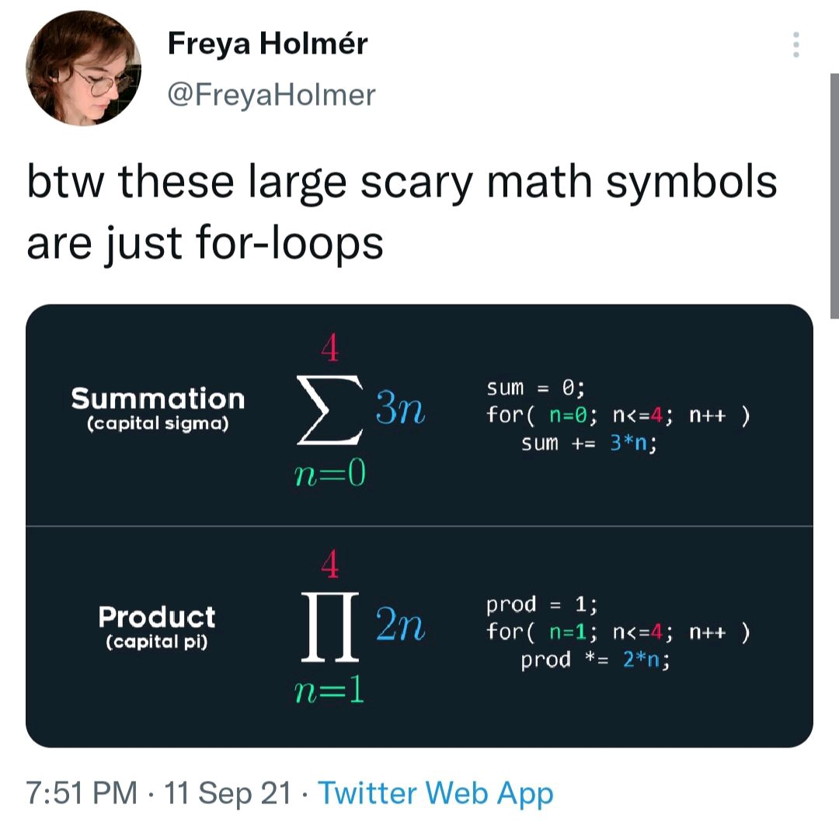
How effective of using for loop – meme explanation

